Slide 1

High Anxiety:Phobias
汇报人：2071360 周威威
2020-11-19

Slide 2
目录Contents
1
What is phobia?
2
Phobia Symptoms.
3
Types of Phobias.
4
Phobia Treatments.

Slide 3
壹
1 Part One
What is phobia?
3

Slide 4

1. What is phobia?
First of all,here is a video of introduction about phobia.
4

Slide 5

1. What is phobia?
A phobia is an irrational fear,a kind of anxiety disorder in which the sufferer has a restless dread of a situation,living creature,place or thing.
phobias are the most common kind of anxiety disorder in the industrial nations:
- Over 50 million people in the USA and 10 million in the UK are thought to live with a phobia.
- Between 8.7% and 18.5% of Americans of all ages suffer from phobias.
4

Slide 6
贰
2 Part Two
Phobia Symptoms.
7

Slide 7
2. Phobia Symptoms
Phobia symptoms can occur through exposure to the feared object or situation, or sometimes merely through thinking about the feared object. Typical symptoms associated with phobias include:
Phobia
Breathlessness
Dizziness
Nausea
Fear of dying
…
A sense of unreality
Trembling
Heartbeat
8

Slide 8

2. Phobia Symptoms
In some cases, these symptoms may escalate into a full-scale anxiety attack.
In response to these symptoms, some individuals may develop social anxiety disorder (SAD)—previously known as social phobia—and begin to isolate themselves, leading to severe difficulties with functioning in daily life and with maintaining relationships.
In other cases, such as with hypochondriasis, a person may seek out medical care due to a constant concern with imagined illnesses or imminent death.
8

Slide 9
叁
3 Part Three
Types of Phobias.
11

Slide 10
3. Types of Phobias
The American Psychiatric Association defines phobias as anxiety disorders and categorizes them into three different types:
01
Agoraphobia
02
Specific phobias
03
Social phobias
12

Slide 11

3. Agoraphobia
This describes a fear of being trapped in an inescapable place or situation. As a result, the phobic individual may begin to avoid such situations. In some cases, this fear can become so pervasive and overwhelming that the individual even fears to leave their home.

Slide 12
1.Specific phobias
More examples of the four major types of specific phobias include:
Animal
Medical
Fear of snakes, rodents, cats, or birds.
Fear of seeing blood or visiting a doctor.
Specific Phobias
Natural environment
situational
Fear of lightning, water, storms, hurricanes, tornadoes, or mudslides.
Fear of bridges, leaving home, or driving.
5

Slide 13



3. Specific phobias
Arachnophobia
Cynophobia
12

Slide 14

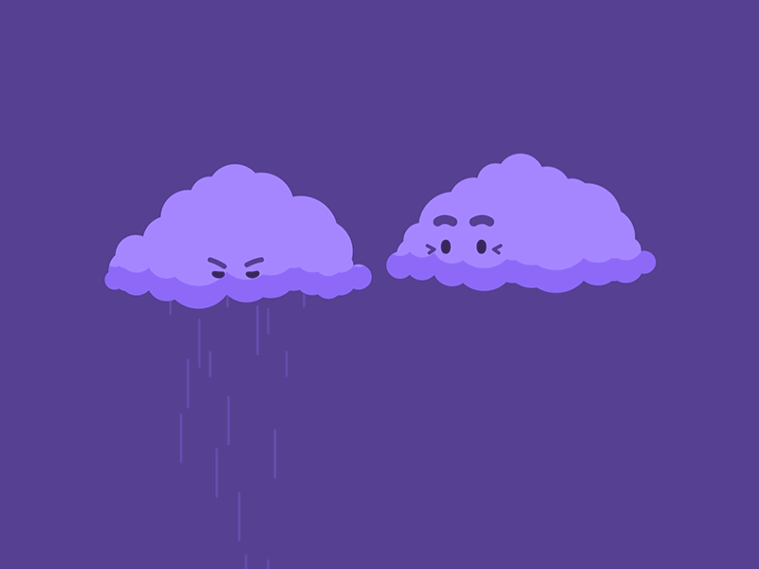
3. Specific phobias
Hemophobia
Astraphobia
12

Slide 15


3. Specific phobias
Aerophobia
Trypophobia
12

Slide 16

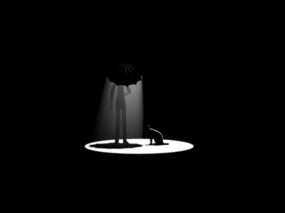
3. Specific phobias
Claustrophobia
Nyctophobia
12

Slide 17

3.Social phobias
A fear of social situations includes an extreme and pervasive fear of social situations. In some cases, this fear may center on a very particular type of social situation such as public speaking. In other instances, people may fear to perform any task in front of other people for fear that they will be somehow publicly embarrassed.

Slide 18
肆
4 Part Four
Phobia Treatments.
15

Slide 19

4. Phobia Treatments
There are a number of treatment approaches for phobias,and the effectiveness of each approach depends on the person and their type of phobia.
In exposure treatments,the person is strategically exposed to their feared object in order to help them overcome their fear. One type of exposure treatment is flooding, in which the patient is confronted by the feared object for an extended length of time without the opportunity to escape. The goal of this method is to help the individual face their fear and realize that the feared object will not harm them.
16

Slide 20
4. Phobia Treatments
Another method often used in phobia treatment is counter-conditioning. In this method, the person is taught a new response to the feared object. Rather than panic in the face of the feared object or situation, the person learns relaxation techniques to replace anxiety and fear.
This new behavior is incompatible with the previous panic response, so the phobic response gradually diminishes. Counter-conditioning is often used with people who are unable to handle exposure treatments and has been effective for treating children and adolescents.
16

Slide 21
4. Phobia Treatments
Finally If you think you may have a phobia, please seek out treatment from a licensed therapist, psychologist, or psychiatrist. You deserve to develop control of this fear, and you can with proper therapy.
16

Slide 22
THANKS
自强不息 知行合一

